Slide 1
OOM: Concepts & Implementation
Procedure Oriented Vs Object Oriented
Class & Objects in Java: Inheritance
  Adding Fields, Methods to a Class
  Instantiating an Object : Understanding the references
  Inheritance & Method Overloading
Objects Oriented Design & UML
OOPS & Java Implementation
  Polymorphism & Abstraction : Java API
GUI in Java & Event Handling
  Applets & Sandbox Security
Software Project Issues: DBMS & OOM
  Connectivity Issues

Slide 2
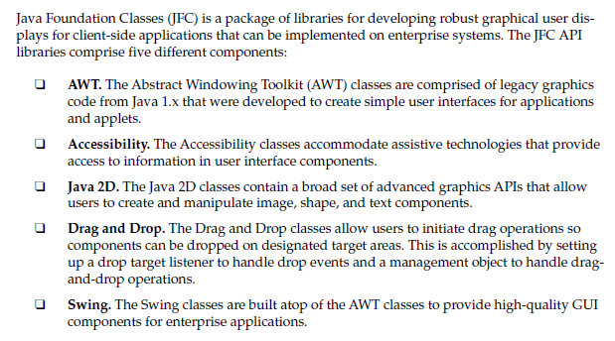
Java Foundation Classes

Slide 3
OOM & Java Implementations
OO Design Principles & Interface
  GoF dictum on Interface
Abstraction & Interface in Java
  Why & How of Abstraction in Java
Class, Abstract Class & Interface
  Similarities & Differences
Polymorphism in Java: Applications
Java APIs & GUI Implementation
  GUI Development & Applets

Slide 4
The Three principles of OOM
Encapsulation
  Objects hide their functions (methods) and data (instance variables)
Inheritance
  Each subclass inherits all variables of its superclass
Polymorphism
Two important effects that stem from inheritance are polymorphism—where an object can take on many forms—
and abstraction—allowing for the creation of abstract classes.
car
Super class
manual
auto-
matic
Subclasses
draw()
draw()

Slide 5
The 03 principles of OOM working together
Inheritance , Encapsulation and Polymorphism when properly applied it can produce a programming environment that supports the development of far more robust & scalable programs than does the process-oriented model.
A well designed hierarchy of classes is the basis for re using the code in which lot of time and expertise was invested in developing & testing.
car
Super class
manual
auto-
matic
Subclasses
draw()
draw()

Slide 6
Software Projects using Java
Polymorphism & Abstraction
&
GUI , Applets in Java

Slide 7
Understanding the Polymorphism
Polymorphism: Introduction
  What is Polymorphism & Why ?
  Method overriding & Method over loading
Class references to Child Objects ?
  Instantiation of Objects: Overview
  Understanding the references
  Polymorphic parameters
  Casting references
  Instanceof Keyword
Benefits of Polymorphism
  Extensibilty
  Heterogeneous Collection

Slide 8
Polymorphism: Inheritance in Java
A Class inheriting Parent Class gets both data and methods (or Functions) of Parent Class and can add new Data3 for Child Class .
Data1
Data2
ParentClass
Method1
But When we want to instantiate objects from these two classes then
What happens if we instantiate the objects of Child type or Parent type
One Object can have many forms & what are the possibilities??
Data3
Method1
ChildClass

Slide 9
Objects instantiation in Multi level Inheritance
Consider a situation when we have Multi level Inheritance and Object instantiation;
  Objects of Class A with reference type A.
  Objects of Class B with reference type B and also of type A.
  Objects of Class C with reference type C and/or of type B , type A.
In OOP the ability of an object to have many forms, which is a direct result of inheritance is known as Polymorphism.
A
B
C

Slide 10
Polymorphism in Java
Suppose there is simple Class Inheritance "Employee“ with Child Classes Hourly and Salary , we want to create objects now.,
How will be objects instantiated ??
Employee
Salary
Hourly

Slide 11
The term Polymorphism (Poly, meaning many or multiple, and Morph, meaning shapes or forms) in OOP refers to the ability of an object to have many forms, which is a direct result of inheritance.

Slide 12
Polymorphism
An object takes on many forms because an object can be treated as a child type, a parent type, a grandparent type, and so on up the hierarchy tree.
When we discussed inheritance, we discussed how the is a relationship is used to determine if your inheritance is a good design.
  The is a relationship is also helpful when learning polymorphism.
  With Polymorphism, we can add new classes with little or no modification in general portions of the program, as long as the new classes are part of the inheritance hierarchy that the program processes generically.

Slide 13
Polymorphism: Methods & Objects
  Polymorphism is the capability of an action or method to do different things based on the object that it is acting upon. Overloading and overriding are two types of polymorphism .
We say a method is polymorphic if the action performed by the method depends on the actual type of the object to which the method is applied.
  Generally, it allows us to mix methods and objects of different types in a consistent way.

Slide 14
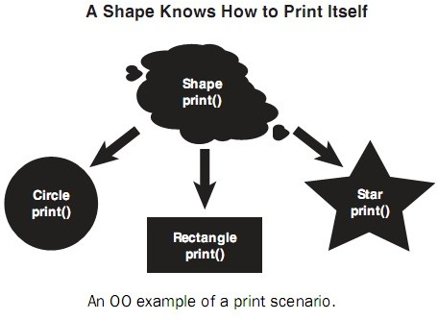
Polymorphism

Slide 15



Polymorphism
  Ex. Bird, Person and Fish are child classes of Animal.
Suppose we wish to create a program that simulates the movement of several types of animals.
Each subclass Bird, Fish and Person extends the Superclass Animal, which contain a method move() maintains an animal’s current location as x-y coordinates.
Each subclass implements method move & overrides the move() method in its own way
Animal
move()
move()
move()
move()

Slide 16
Polymorphism for Simulation program
We design a program which maintains the array of references to objects of the various Animal subclass.
  To simulate the animal’s movements, the program sends each object the same message once per second move().
However each specific type of Animal responds to a move message in a unique way:
  A Fish swim three feet,
  A Bird might fly ten feet
  A Person may walk five feet.
Each Object know how to modify its x-y coordinates appropriately for its specific types of movements.
Capability of each object to “do the right thing” in response to the same method call is resulting in to a variety of objects having “many forms” of results thus termed as Polymorphism

Slide 17
Polymorphic behaviour
Following statements are used to implement Polymorphic behaviour of various Objects
Animal [] A = new Animal[3];
A[0] = new Bird();
A[1] = new Person();
A[2] = new Fish();
for (int i = 0; i < A.length; i++)
A[i].move();
References are all the same, but objects are not
Method invoked is that associated with the OBJECT, NOT with the reference

Slide 18
Polymorphism
Any java object that can pass more than one IS-A test is considered to be polymorphic.
In Java, all java objects are polymorphic since any object will pass the IS-A test for their own type and for the class Object.
It is important to know that the only possible way to access an object is through a reference variable.
A reference variable can be of only one type. Once declared the type of a reference variable cannot be changed.

Slide 19
Polymorphism & Reference variables
The reference variable has significant characteristics and thus a role to support polymorphic activities.
The reference variable can be reassigned to other objects provided that it is not declared final.
The type of the reference variable would determine the methods that it can invoke on the object.
A reference variable can refer to any object of its declared type or any subtype of its declared type. A reference variable can be declared as a class or interface type.

Slide 20
Instantiating an Object: Overview
In Java, the new keyword is used to instantiate an object. The new operator creates the object in memory and returns a reference to the newly created object.
This object will remain in memory as long as your program retains a reference to the object.
The following statements declare an Employee reference and use the new keyword to assign the reference to a new Employee object. Employee e = new Employee();
While instantiating objects it emphasizes the important fact that two entities are being created in memory: the reference and the object.
The reference e is declared as a reference to an Employee, meaning that e can refer to any Employee object.
The reference e is not an object.
The object itself does not have a variable name, and the only way you can access and use the object is to use a reference to the object.

Slide 21
References:Overview
A reference is a 32-bit integer value that contains the memory address of the object it refers to.
While references are essentially integers, still they need to be declared as a particular data type.
This is because data types are strictly enforced in Java.
A reference must be of a particular class data type.
For example, in the following statements, two Employee references and one String reference are allocated in memory.
Employee e1, e2;
String s;
Each of these three references consumes the same amount of memory and is essentially an integer data type.
However, the references e1 and e2 can refer only to Employee objects.
The reference s can refer only to a String object.

Slide 22
Polymorphism: Parent Class reference
To demonstrate polymorphism in action, we will use the following Employee and Salary classes,
Notice that the Employee class has
  three fields: name, address, and number;
  one constructor;
  a mailCheck() method; the toString() method;and various accessor methods.
  There are no fields in the Employee class used to represent the employee’s pay because we decided that this data should appear in the child classes.

Slide 23
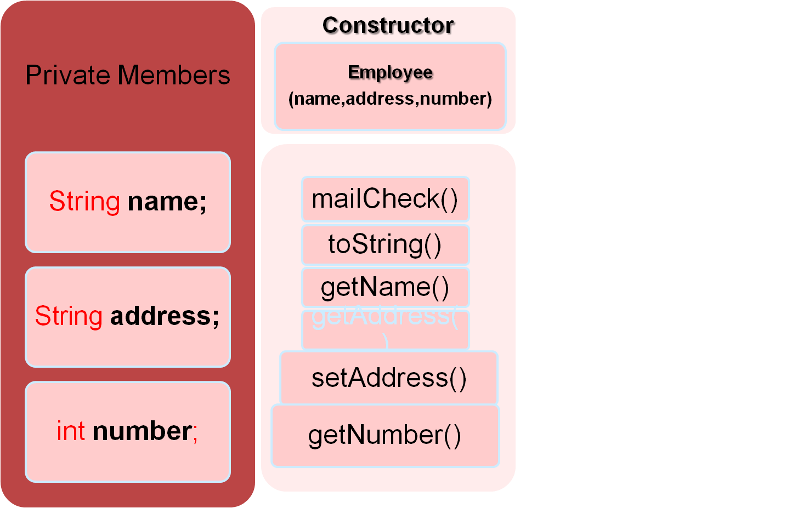
The Employee Class
Methods

Slide 24
public void mailCheck()
{
System.out.println(“Mailing a check to “ + this.name
+ “ “ + this.address);
}
public String toString()
{
return name + “ “ + address + “ “ + number;
}
public String getName()
{
return name;
}
public String getAddress()
{
return address;
}
public void setAddress(String newAddress)
{
address = newAddress;
}
public int getNumber()
{
return number;
}
}
public class Employee
{
private String name;
private String address;
private int number;
public Employee(String name, String address, int number)
{
System.out.println(“Constructing an Employee”);
this.name = name;
this.address = address;
this.number = number;
}
The Employee class extends Object implicitly

Slide 25
Child Class…
The Salary class, shown on next slide, has one field named salary to represent the annual pay of an employee. The Salary class also has one constructor, a computePay() method, and various accessor and mutator methods.
The idea behind this design is that not every Employee has a salary, so adding a salary field in the Employee class would cause issues later; therefore, the child classes of Employee will contain the fields and methods needed to compute the employee’s pay.
As the Hourly class that also extends Employee, and it will have fields for an hourly wage and number of hours worked, as well as a computePay() method.

Slide 26
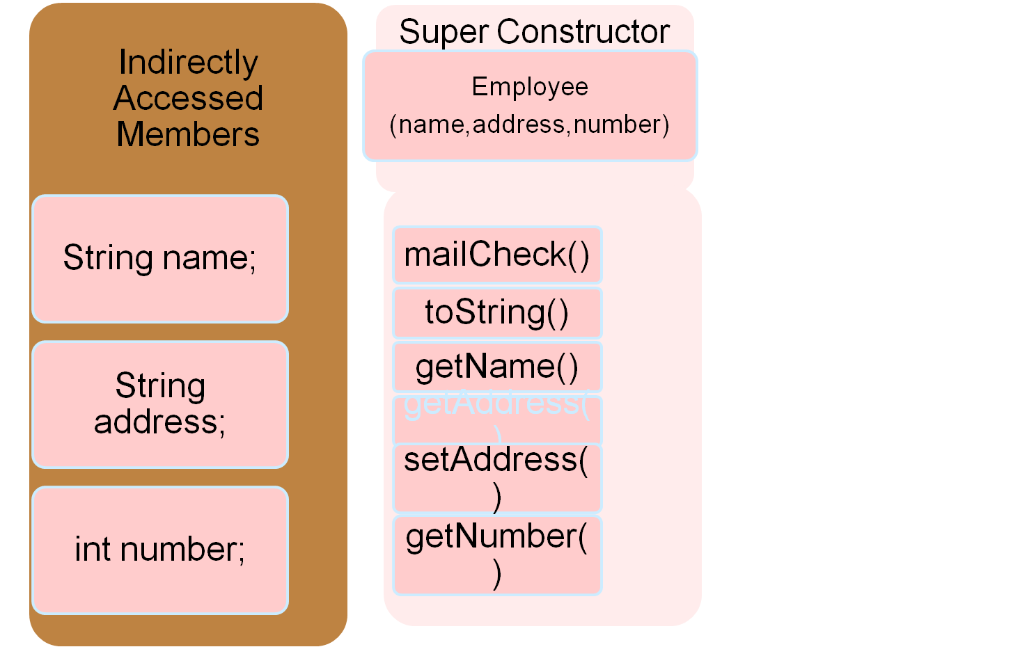
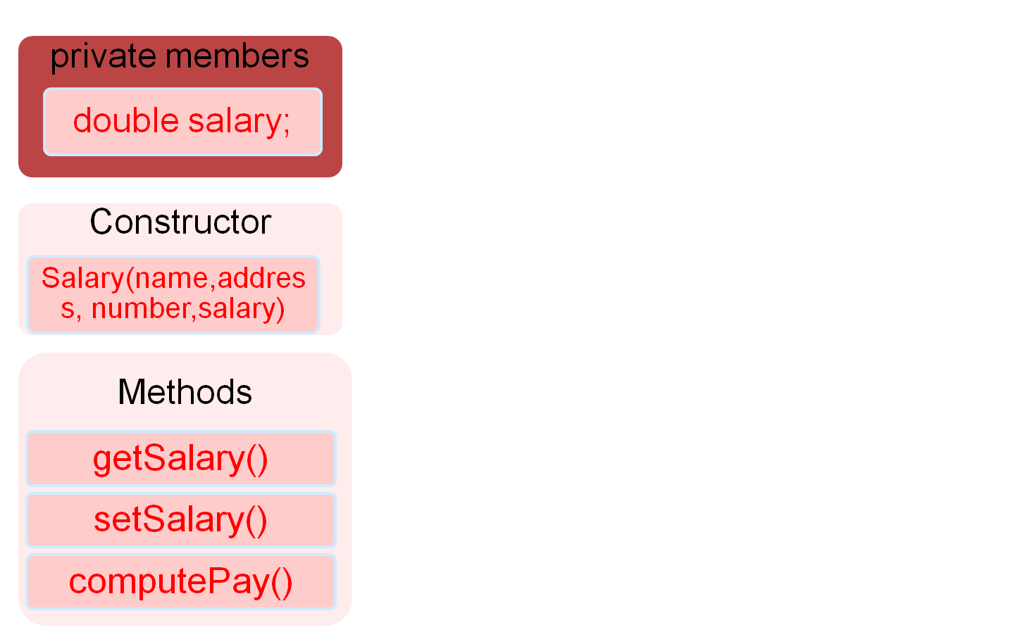
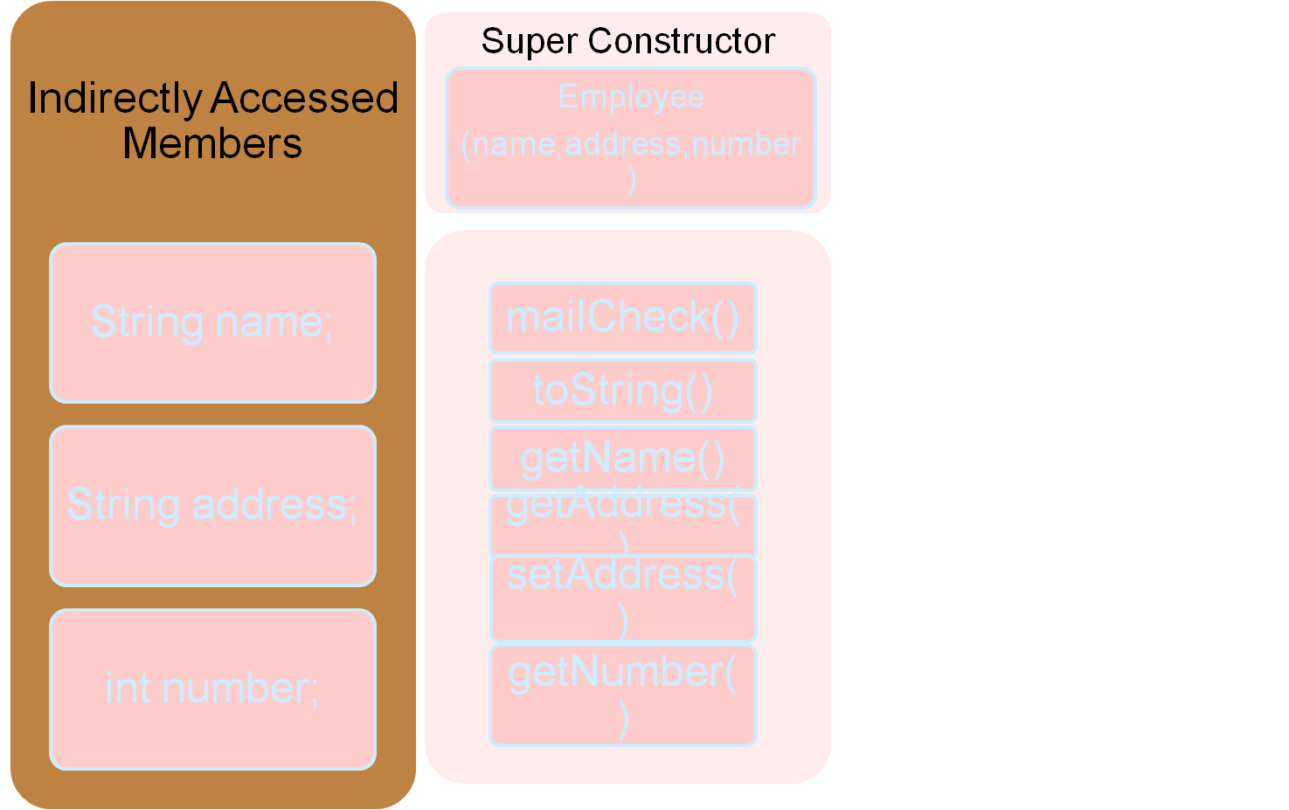
The Salary Class
Inherited Methods

Slide 27
public class Salary extends Employee
{
private double salary; //Annual salary
public Salary(String name, String address, int number,
double salary)
{
super(name, address, number);
setSalary(salary);
}
public double getSalary()
{
return salary;
}
public void setSalary(double newSalary)
{
if(newSalary >= 0.0)
{
salary = newSalary;
}
}
public double computePay()
{
System.out.println(“Computing salary pay for “ + getName());
return salary/52;
}
}

Slide 28
Now, let’s look at a couple of statements. Suppose that we instantiated an Employee object as follows:
Employee e = new Employee(“George W. Bush”, “Houston, TX”, 43);
The previous statement creates two entities in memory: the Employee reference e, and the Employee object to which the e gets assigned. The reference is of type Employee, and so is the object it refers to.
Similarly, the following statement is valid:
Salary s = new Salary(“George Washington”, “Valley Forge, DE”, 1, 5000.00);
In this statement, s is a Salary reference, and it is assigned to a new Salary object. Both the reference and the object are of type Salary.

Slide 29
Polymorphism
Now, take a look at a statement that at first glance might seem strange
Employee p = new Salary(“ Reuther”, “Rapid City, SD”, 47, 250000.00);
The left side of the equation creates a reference p of type Employee. The right side of the equation is a new Salary object. Can you assign an Employee reference to point to a Salary object? Are they compatible data types?
The answer to both questions is yes. The is a relationship carries over to polymorphism. The right side of the equation is a Salary object. A Salary object is an Employee object.
Can p refer to an Employee object?
Certainly. In fact, p can refer to an Employee object, and because a Salary object is an Employee object, p can refer to a Salary object as well.

Slide 30
Polymorphism
From the point of view of polymorphism, a Child object is an Parent object.
A child object being treated as a parent class type has the following benefits:
Using a parent class reference to a child object.
Using polymorphic parameters and return values.
Creating heterogeneous collections of objects, where not all objects in the collection are of the same type.
As we know that Polymorphism is the ability of an object to take on many forms. The most common use of polymorphism in OOP occurs when a parent class reference is used to refer to a child class object.
This means a Salary object can be treated as an Employee object.

Slide 31
Using Parent Class References to Child Objects
A child object can be referenced using a parent class reference.
This is the most fundamental use of polymorphism because using a parent class reference to refer to a child object is what allows you to take advantage of the benefits of polymorphism.

Slide 32
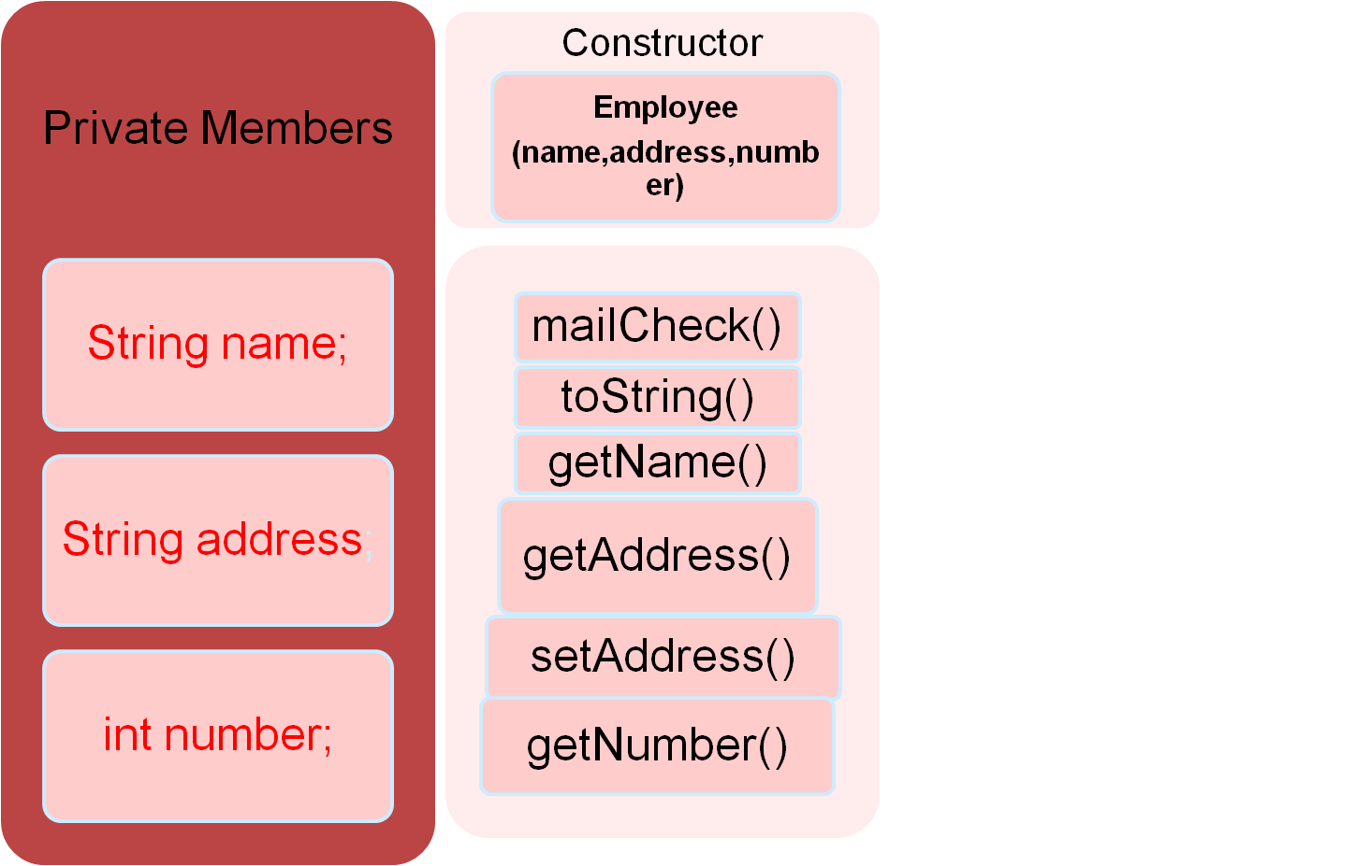
The Employee Class
Methods

Slide 33
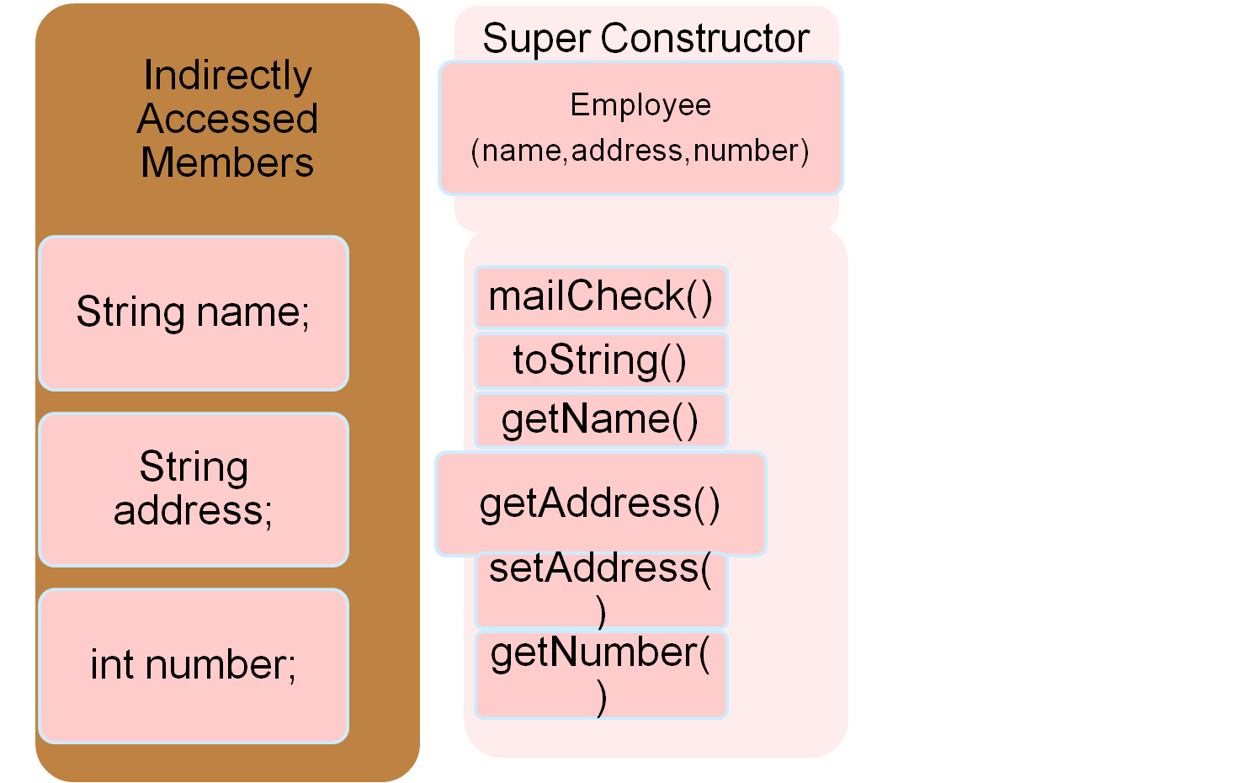
The Salary Class
Inherited Methods

Slide 34
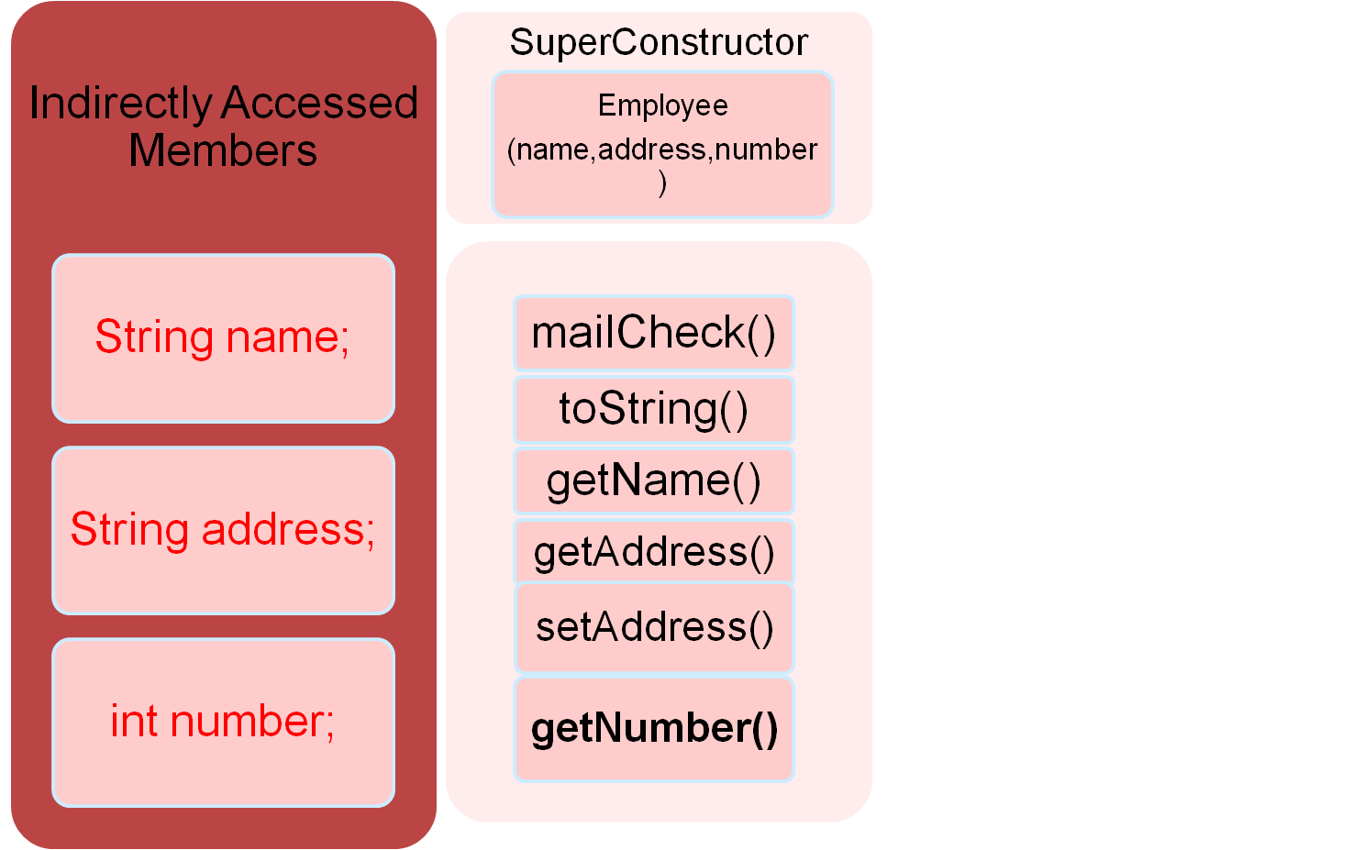
Polymorphism Example
Employee p = new Salary(“ Reuther”, “Rapid City, SD”, 47, 250000.00);
In the Object p, the unique features of the Salary Class are absent.
The only attributes that are present, are the ones inherited from the Employee Class.
Inherited Methods

Slide 35
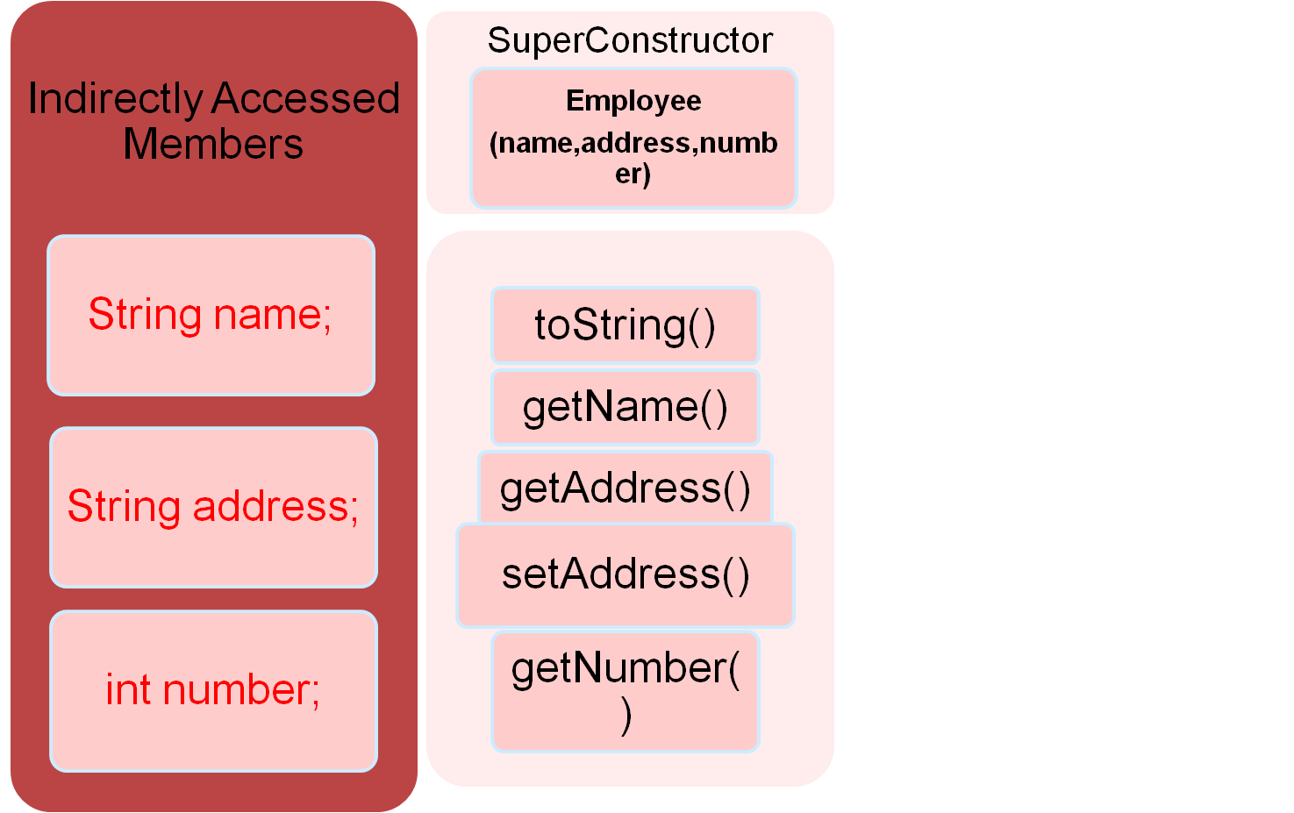
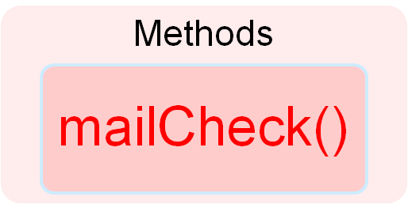
Polymorphism Example
Employee p = new Salary(“ Reuther”, “Rapid City, SD”, 47, 250000.00);
In case methods/members with same name exist in the classes, they will be overridden in this object.
eg: if the Salary class has a separate mailCheck() method, then the case will be:
Inherited Methods

Slide 36
Polymorphism
Why use an Employee reference to refer to a Salary object? Whynot just use a Salary reference?
There are situations where using a parent class reference can make your code easier to write and easier to maintain. You can think of an Employee reference as a more generic reference than a Salary reference. Suppose that we have Hourly and Salary classes that both extend Employee. I can then reference each employee’s object as either a Salary or Hourly, using a Salary or an Hourly reference. Or I can treat each employee’s object as an Employee, and use an Employee reference to refer to any employee, no matter what data type the employee actually is.
Q: But what do we gain from doing this?
A: By treating Hourly and Salary objects as type Employee, I can store them in the same data structure (an example of a heterogeneous collection). I can also write a method that has an Employee parameter, which allows both Salary and Hourly objects to be passed in to that method (an example of polymorphic parameters).

Slide 37
Polymorphism: discussions
.
Q: If you treat a Salary object as an Employee, don’t you lose the Salary part of the object?
No. The object does not change, just the data type of the reference to it. This is an important point to understand. If I instantiate a Salary object, I get a Salary object, no matter what data type its reference is.
Q: So why not always use a parent class reference if it doesn’t change anything?
A: Well, be careful. I said the object does not change, but how it is viewed does change. If I use an Employee reference to a Salary object, the object does not lose any data, but I lose the ability to access those fields and methods from the Salary class using the parent class reference.
Q: You can never access them? Then you have lost something.
A: No, you can still access them, but you have to cast the Employee reference to a Salary reference. We need to know the casting process first. It can then be shown with examples where using a parent class reference to a child object is advantageous.

Slide 38
/* File name : Employee.java */
public class Employee
{ private String name; private String address; private int number;
public Employee(String name, String address, int number)
{ System.out.println("Constructing an Employee");
this.name = name; this.address = address; this.number = number; }
public void mailCheck()
{ System.out.println("Mailing a check to " + this.name + "
" + this.address); }
public String toString()
{ return name + " " + address + " " + number; }
public String getName()
{ return name; }
public String getAddress() { return address; }
public void setAddress(String newAddress)
{ address = newAddress; } public int getNumber() { return number; }
/* File name : Salary.java */
public class Salary extends Employee
{ private double salary; //Annual salary
public Salary(String name, String address, int number, double salary) { super(name, address, number); setSalary(salary); } public void mailCheck() { System.out.println("Within mailCheck of Salary class "); System.out.println("Mailing check to " + getName() + " with salary " + salary); } public double getSalary() { return salary; } public void setSalary(double newSalary) { if(newSalary >= 0.0) { salary = newSalary; } } public double computePay() { System.out.println("Computing salary pay for " + getName()); return salary/52; } }
Now suppose we extend Employee class as follows:

Slide 39
Now, you study the following program carefully and try to determine its output:
/* File name : VirtualDemo.java */
public class VirtualDemo
{ public static void main(String [] args)
{ Salary s = new Salary("Mohd Mohtashim", "Ambehta, UP", 3, 3600.00);
Employee e = new Salary("John Adams", "Boston, MA", 2, 2400.00);
System.out.println("Call mailCheck using Salary reference --");
s.mailCheck(); System.out.println("\n Call mailCheck using Employee reference--"); e.mailCheck(); } }
This would produce the result as shown:
Constructing an Employee
Constructing an Employee Call mailCheck
using Salary reference –
Within mailCheck of Salary class
Mailing check to Mohd Mohtashim with salary 3600.0
Call mailCheck using Employee reference–
Within mailCheck of Salary class
Mailing check to John Adams with salary 2400.0

Slide 40
Virtual Methods
Here, we instantiate two Salary objects . one using a Salary reference s, and the other using an Employee reference e.
While invoking s.mailCheck() the compiler sees mailCheck() in the Salary class at compile time, and the JVM invokes mailCheck() in the Salary class at run time.
Invoking mailCheck() on e is quite different because e is an Employee reference. When the compiler sees e.mailCheck(), the compiler sees the mailCheck() method in the Employee class.
Here, at compile time, the compiler used mailCheck() in Employee to validate this statement. At run time, however, the JVM invokes mailCheck() in the Salary class.
This behavior is referred to as virtual method invocation, and the methods are referred to as virtual methods. All methods in Java behave in this manner, whereby an overridden method is invoked at run time, no matter what data type the reference is that was used in the source code at compile time.

Slide 41
The 03 principles of OOM works together
Inheritance , Encapsulation and Polymorphism when properly applied it can produce a programming environment that supports the development of far more robust & scalable programs than does the process-oriented model.
A well designed hierarchy of classes is the basis for re using the code in which lot of time and expertise was invested in developing & testing.
car
Super class
manual
auto-
matic
Subclasses
draw()
draw()

Slide 42
Polymorphism: Methods & Objects
We say a method is polymorphic if the action performed by the method depends on the actual type of the object to which the method is applied.
  Generally, it allows us to mix methods and objects of different types in a consistent way.
  We have seen that with well designed inheritance hierarchy , we can use polymorphic parameters to get some interesting result, while using Parent class references for Child class objects

Slide 43
The Salary Class
Inherited Methods

Slide 44
Polymorphism Example
Employee p = new Salary(“ Reuther”, “Rapid City, SD”, 47, 250000.00);
In the Object p, the unique features of the Salary Class are absent.
The only attributes that are present, are the ones inherited from the Employee Class.
Inherited Methods

Slide 45
Polymorphism Example
Employee p = new Salary(“ Reuther”, “Rapid City, SD”, 47, 250000.00);
In case methods/members with same name exist in the classes, they will be overridden in this object.
eg: if the Salary class has a separate mailCheck() method, then ;
what the case will be ?
How this method of Salary Class gets invoked?
Inherited Methods

Slide 46
Polymorphism
Though We have treated a Salary object as an Employee, the object does not change, just the data type of the reference to it changes ! This is an important point to understand. If we instantiate a Salary object, we get a Salary object, no matter what data type its reference is.
We lose the ability to access those fields and methods from the Salary class using the parent class reference. How can we access them? Have we lost something ?
No, we can still access them, but we have to cast the Employee reference to a Salary reference. We need to know the casting process first. It can then be shown with examples where using a parent class reference to a child object is advantageous.
By treating Hourly and Salary objects as type Employee, we can store them in the same data. I can also write a method that has an Employee parameter, which allows both Salary and Hourly objects to be passed in to that method (an example of polymorphic parameters)

Slide 47
Heterogeneous Collections
We have seen that by treating Hourly and Salary objects as type Employee, we can store them in the same data structure.
A common use of polymorphism is to create a collection of data that is not all the same type, but has a common parent. A collection of different objects is referred to as a heterogeneous collection.

Slide 48
Heterogeneous Collection
For example, suppose that we wanted to use an array to keep track of the employees of a company. When creating an array, all the data in the array must be of the same type.
  Because there are two types of employees, we could create an array for Salary objects and a second array for Hourly objects.
Because Salary and Hourly objects are Employee objects, however, we can create a single array for Employee objects that can contain both Salary and Hourly objects.
This is an example of a heterogeneous collection because the elements in the array will not all be the same.
They will all be Employee objects, but some will be Salary objects and some will be Hourly objects. While Salary and Hourly have a common parent, they are different objects.

Slide 49
Multiple inheritance …
References can be explored in multiple inheritance, Ex.:
public interface Vegetarian{}
public class Animal{}
public class Deer extends Animal implements Vegetarian{}
Now the Deer class is considered to be polymorphic since this has multiple inheritance. Following are true for the above example:
A Deer IS-A Animal
A Deer IS-A Vegetarian
A Deer IS-A Deer
A Deer IS-A Object
When we apply the reference variable facts to a Deer object reference, the following declarations are legal:
Deer d = new Deer();
Animal a = d;
Vegetarian v = d; Object o = d;
All the reference variables d,a,v,o refer to the same Deer object in the heap.

Slide 50
Casting Process & Polymorphic behavior
Java is strict about letting you assign variables only to values that match the variable’s data type.
If x is an int, you cannot assign it to other data types unless you use the cast operator.
Casting process can help us in implementing many desired scenario with Inheritance, polymorphism and encapsulation .

Slide 51
Java Primitive data types
byte 8 bits
short 16 bits
int 32 bits
long 64 bits
float 32 bits
double 64 bits
char 16 bits

Slide 52
Casting Process
Java is strict about letting you assign variables only to values that match the variable’s data type.
If x is an int, you cannot assign it to other data types unless you use the cast operator.
For example, the following statements declare x as an int and then attempt to assign x to a floating-point value.
int x;
double d = 3.5;
x = d; //This does not compile!
x = (int) d; //This does compile since the cast operator is used.
The cast operator consists of placing the data type that the value is being cast to in parentheses. In this example, d was being cast to an int, so int was placed in parentheses right before d.

Slide 53
Casting References
Casting tells the compiler that you are aware of the invalid assignment, but you want to do it anyway. In the ex. above, x was assigned to d by casting, and x will be the value 3.
Casting a floating-point number to an integer data type causes the decimal part of the number to be truncated.
For ex., suppose that we have a double (64 bits) that we want to store in a float (32 bits) . Even if the double fits easily in the float, the compiler still requires us to use the cast operator:
double pi = 3.14159;
float a = pi; //Does not compile!
float b = (float) pi; //Works fine
We may think the compiler should be smart enough to realize that 3.14159 fits into a float, so no casting is necessary; however, it is important to realize that the compiler only knows data types.
When we assign a 64-bit double to a 32-bit float, the compiler only sees a larger piece of data being stored in a smaller piece. Because data could be lost, the cast operator tells the compiler you know what you are doing, and any loss of data is acceptable.

Slide 54
Types of Inheritance & Polymorphic behavior
A
A
A
B
A
B
B
C
D
C
B
Hierarchical
Inheritance
Multiple
Inheritance
C
Single
Inheritance
Multi Level
Inheritance

Slide 55
Casting Process & Polymorphic behavior
Java is strict about letting you assign variables only to values that match the variable’s data type.
If x is an int, you cannot assign it to other data types unless you use the cast operator.
Casting process can help us in implementing many desired scenario with Inheritance, polymorphism and encapsulation.
We can see the benefit of polymorphism known as polymorphic parameters.
When a method has a parameter that is a reference, any object that is compatible with that reference can be passed in, allowing a method to accept parameters of different data types. Thus polymorphic behaviour

Slide 56
Casting the References
Suppose we instantiate two Salary objects as follows:
Salary s = new Salary(“George Washington”,
“Valley Forge, DE”, 1, 5000.00);
Employee e = new Salary(“Rich Raposa”, “Rapid City, SD”, 47, 250000.00);
It is emphasized that these two statements create two Salary objects; each object consumes the same amount of memory and has the same methods and fields allocated in memory.
The only difference between these two objects is the particular data stored in their respective fields.
Because s is a Salary reference, we can use s to invoke the accessible fields and methods of both the Salary and Employee class. For example, the following statements are valid:
s.setSalary(100000.00); //A Salary method
s.computePay(); //A Salary method
s.mailCheck(); //An Employee method

Slide 57
Casting in References
Because e is an Employee reference, we can use e to only invoke the accessible methods of the Employee class.
For example, we can use e to invoke mailCheck(),but we cannot use e to invoke setSalary() or computePay():
e.setSalary(500000.00); //Does not compile!
e.computePay(); //Does not compile!
e.mailCheck(); //An Employee method, so this compiles
The Salary object referenced by e has a setSalary() and a mailCheck() method; however, the compiler thinks e refers to an Employee, and attempting to invoke setSalary() or mailCheck() generates a compiler error.
We need to use the cast operator on e, casting e to a Salary reference, before the Salary methods can be invoked using e. The following statements demonstrate two techniques for casting e to a Salary reference:
((Salary) e).computePay();
Salary f = (Salary) e;
f.computePay();

Slide 58
GoF & OOM
GoF proposed some significant concepts and compelled the OOM community to re-think the basics ;
“ Program to an 'interface', not an 'implementation'. " (Gang of Four 1995:18)
"Favor 'object composition' over 'class inheritance'." (Gang of Four 1995:20)
  The GoF gave significance to interface as effective reuse, whereas Interfaces concepts originates from the concept known as Abstraction.

Slide 59
Object Composition in Java
Composition is the design technique to implement has-a relationship in classes.
Java composition is achieved by using instance variables that refers to other objects.
For example, a Person has a Job.
public class Person {
//composition has-a relationship
private Job job;
public Person(){
this.job=new Job();
job.setSalary(1000L);
}
public long getSalary() {
return job.getSalary();
}
}
public class Job {
private String role;
private long salary;
private int id;
public String getRole() {
return role;
}
public void setRole(String role) {
this.role = role;
}
public long getSalary() {
return salary;
}
public void setSalary(long salary) {
this.salary = salary;
}
public int getId() {
return id;
}
public void setId(int id) {
this.id = id;
}
}
public class TestPerson {
public static void main(String[] args) {
Person person = new Person();
long salary = person.getSalary();
}
}

Slide 60
Advantages of Object Composition in Java
Client program is not affected by any change in the composed object.
We can control the visibility of other object to client classes and reuse only what we need.
Composition allows creation of back-end class when it’s needed, for example we can change Person getSalary method to initialize the Job object.
Composition is mostly preferred when multiple inheritance is required in java.
Java doesn’t support multiple inheritance in classes because it can lead to diamond problem

Slide 61
Abstraction
Abstraction refers to the ability to make a class abstract in OOP.
  An abstract class is one that cannot be instantiated.
All other functionality of the class still exists, and its fields, methods, and constructors are all accessed in the same manner.
  You just cannot create an instance of the class.
Why write a class and not allow anyone to create instances of it?
In most situations, the design of the class is such that no one would want an instance of the class.
An important development Interface is derived from the Abstraction….

Slide 62
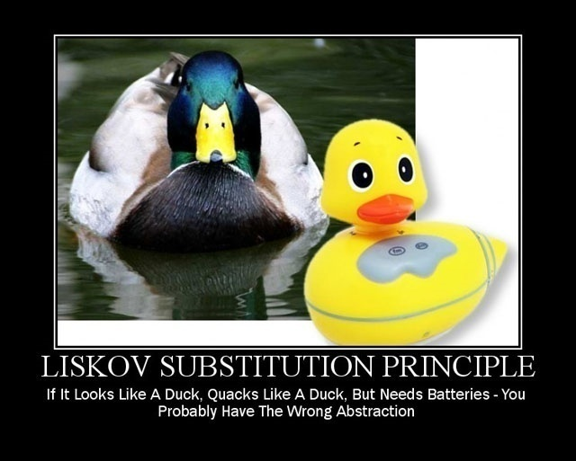
Inappropriate Abstraction may lead
to erroneous OO Modelling…..

Slide 63
Having appropriate Abstraction is emphasized
by OOM Researchers and practitioners

Slide 64
Abstraction
Tony Hoare: “Abstraction arises from a recognition of similarities between certain objects, situations, or processes in the real world, and the decision to concentrate upon those similarities and to ignore for the time being the differences.”
Grady Booch: “An abstraction denotes the essential characteristics of an object that distinguish it from all other kinds of objects and thus provide crisply defined conceptual boundaries, relative to the perspective of the viewer.”
Abstraction is one of the fundamental ways to deal with complexity
An abstraction focuses on the outside view of an object and separates an object’s behavior from its implementation

Slide 65
Abstraction
.
If it is asked to you to draw a picture of a Mammal, you would likely draw a dog, horse, person, or something similar.
If I asked you to draw a picture of something that was just a mammal, you can see how the concept of a mammal is abstract.
Many animals are Mammals, but no animal is just a mammal. It seems logical, therefore, that no one would need to instantiate an object of type Mammal (assuming that we wrote a Mammal class).
Similarly, if we return back to our old example of Employee Pay roll Software , all of our employees in our company are of type Employee, but no one is just an Employee.
It seems logical that no one would need to instantiate an object of type Employee, and it should be declared abstract.

Slide 66
Inheritance is just the beginning
Polymorphism & Abstraction in Java

Slide 67
Inheritance in Java
Similarly, if we return back to our old example of Employee Pay roll Software,
Inheritance relation between Employee Class (Parent Class) and Salary Class (Child Class) ,
While looking at Object Instantiation of all the three Classes, some strange thing was observed
It seems logical that no one would need to instantiate an object of type Employee, and it should be declared abstract
Employee
Salary
Hourly

Slide 68
Implementing Inheritance
A class uses the extends keyword to inherit from another class.
It appears after the class name when declaring the class and is followed by the name of the class being extended.
For Ex, the Salary class is a child of the Employee class:
public class Salary extends Employee
Similarly, the Hourly class can extend Employee with the statement:
public class Hourly extends Employee
The following Employee class will be used as the parent of Salary and Hourly. No special code to denote that Employee is a parent class.
public class Employee
{ public String name;
public String address;
public int SSN;
public int number;
public void mailCheck()
{
System.out.println(“Mailing a check to “ + name
+ “ “ + address);
} }

Slide 69
The following Salary class uses the extends keyword to denote Salary is a child class of Employee.
public class Salary extends Employee
{
public float salary; //Annual salary
public float computePay()
{
System.out.println(“Computing salary pay for “ + name);
return salary/52;
}
}

Slide 70
Similarly, the following Hourly class extends the Employee class using the extends keyword.
public class Hourly extends Employee
{
public float hourlyRate; //Pay rate
public float hoursWorked; //Weekly hours worked
public float computePay()
{
System.out.println(“Computing hourly pay for “ + name);
float pay = 0.0;
if(hoursWorked <= 40)
{
pay = hourlyRate * hoursWorked;
}
else //Need to compute overtime
{
pay = (hourlyRate * 40) +
(hourlyRate * (hoursWorked - 40) * 1.5);
}
return pay;
}
}

Slide 71
We have defined the Employee, Salary, and Hourly classes,
Let’s look
at a program that instantiates and uses these classes.
The following Inherit-
Demo program creates an Employee, Salary, and Hourly object.
Study the program
carefully and try to determine its output

Slide 72
public class InheritDemo
{public static void main(String [] args)
{System.out.println(“Instantiating an Employee”);
Employee e = new Employee();
e.name = “Robert Smith”;
e.address = “111 Java Street”;
e.SSN = 999001111;
e.number = 1;
System.out.println(“Instantiating a Salary”);
Salary s = new Salary();
s.name = “Jane Smith”;
s.address = “222 Oak Drive”;
s.SSN = 111009999;
s.number = 2;
s.salary = 100000.00F;
System.out.println(“Instantiating an Hourly”);
Hourly h = new Hourly();
h.name = “George Washington”;
h.address = “333 Espresso Lane”;
h.SSN = 111990000;
h.number = 3;
h.hourlyRate = 10.00F;
h.hoursWorked = 50;
System.out.println(“Payingemployees”);
//e.computePay(); //Does not compile!
System.out.println(s.number + “ “ + s.computePay());
System.out.println(h.number + “ “ + h.computePay());
System.out.println(“Mailing checks”);
e.mailCheck();
s.mailCheck();
h.mailCheck();
}}

Slide 73
The InheritDemo program starts by instantiating each of the three employee
types and initializing their fields.
Up until the “Paying employees” statement,
the only output is:
Instantiating an Employee
Instantiating a Salary
Instantiating an Hourly

Slide 74
Invoking the computePay() methods on the Salary and Hourly objects generates
the following output:
Paying employees
Computing salary pay for Jane Smith
2 1923.0769
Computing hourly pay for George Washington
3 550.0
Notice that the Employee object referenced by e in the InheritDemo program cannot invoke the computePay() method because the object does not have a computePay() method.
In fact, there is no place to put information about how or what Robert Smith is paid.
It is safe to say that no employee at the company will want to be of type Employee.

Slide 75
The mailCheck() method is available to all three objects in the InheritDemo
program.
Invoking them causes the following output:
Mailing checks
Mailing a check to Robert Smith 111 Java Street
Mailing a check to Jane Smith 222 Oak Drive
Mailing a check to George Washington 333 Espresso Lane

Slide 76
All of our Employees in our company are of type Employee, but no one is just an Employee.
Any Employee is either Hourly Employee or Salary Employee but can not be ONLY Employee !!

Slide 77
Abstraction
The Employee class is a perfect example of a class that really does not need to be instantiated from a design perspective.
Notice that the employee did not have any information about how much it is paid, and its computePay() method may simply return 0.0.
It is safe to say that no employee of our company would want to be strictly an Employee object (and not one of the child class types).
We can make it so that no one can instantiate an Employee object, by declaring the Employee class abstract.
This has no effect on how the fields, methods, and constructors behave.
Notes:
Ranjana vyas

Slide 78
Abstract Class
public abstract class Employee
{
private String name;
private String address;
private int number;
public Employee(String name, String address, int number)
{
System.out.println(“Constructing an Employee”);
this.name = name;
this.address = address;
this.number = number;
}
public double computePay()
{
System.out.println(“Inside Employee computePay”);
return 0.0;
}
public void mailCheck()
{
System.out.println(“Mailing a check to “
+ this.name + “ “ + this.address);
}
public String toString()
{
return name + “ “ + address + “ “ + number;
}
public String getName()
{
return name;
}
public String getAddress()
{
return address;
}
public void setAddress(String newAddress)
{
address = newAddress;
}
public int getNumber()
{
return number;
}
}

Slide 79
public class AbstractDemo
{
public static void main(String [] args)
{
Employee s = new Salary(“Thomas Jefferson”, “Monticello, VA”,
3, 2600.00);
Employee h = new Hourly(“John Adams”, “Boston, MA”, 2, 2.50);
Employee e = new Employee(“George W.”, “Houston, TX”, 43);
System.out.println(s.getName() + “‘s pay is $”
+ s.computePay());
((Hourly) h).setHoursWorked(50);
System.out.println(h.getName() + “‘s pay is $”
+ h.computePay());
} }
OUTPUT AbstractDemo.java:
Employee is abstract;
Cannot be instantiated
Employee e = new Employee(“George W.”, “Houston, TX”, 43);
^
1 error
If this statement is commented out, the program will compile and execute fine, and the output is shown in next slides…

Slide 80

Output

Slide 81
Abstract Methods
Abstract Methods do not provide implementations and a Class that contains any abstract methods must be declared as Abstract Class even if that Class contains some concrete (nonabstract ) methods.
If you want a class to contain a particular method but you want the actual implementation of that method to be determined by child classes, you can declare the method in the parent class as abstract.
Abstract methods consist of a method signature, but no method body.
Notes:
Ranjana vyas

Slide 82
Abstract Methods
public abstract class Employee
{
private String name;
private String address;
private int number;
public abstract double computePay();
//Remainder of class definition
}
You can still create Employee references, such as the reference e in the previous statements; however, you cannot use the new operator on Employee if the Employee class is declared abstract.

Slide 84
What Is an Interface?
As we've already learned, objects define their interaction with the outside world through the methods that they expose.
Methods form the object's interface with the outside world;
  the buttons on the front of your television set, for example, are the interface between you and the electrical wiring on the other side of its plastic casing. You press the "power" button to turn the television on and off.
In its most common form, an interface in OOPS is a group of related methods with empty bodies.
  An interface is a collection of abstract methods.
A class implements an interface, thereby inheriting the abstract methods of the interface.
Unless the class that implements the interface is abstract, all the methods of the interface need to be defined in the class.
Notes:
Ranjana vyas

Slide 85
An Overview of Interfaces
Interfaces form a contract between the class and the outside world, and this contract is enforced at build time by the compiler.
If our class claims to implement an interface, all methods defined by that interface must appear in its source code before the class will successfully compile.
An interface is similar to a class in the following ways:
An interface can contain any number of methods.
An interface is written in a file with a .java extension, with the name of the interface matching the name of the file.
The bytecode of an interface appears in a .class file.
Interfaces appear in packages, and their corresponding bytecode file must be in a directory structure that matches the package name.
Notes:
Ranjana vyas

Slide 86
Implementing an Interface
When a class implements an interface, you can think of the class as signing a contract, agreeing to perform the specific behaviors of the interface.
If a class does not perform all the behaviors of the interface, the class must declare itself as abstract.
More specifically, when a class implements an interface, the class has two options:
Implement all of the methods in the interface
Be declared as abstract
A class uses the implements keyword to implement an interface. The implements keyword appears in the class declaration following the extends portion of the declaration.
The format for implements looks similar to:
public class ClassName extends ParentClassName implements InterfaceName

Slide 87
Interface
However, an interface is different from a class in several ways, including:
■■ We cannot instantiate an interface.
■■ An interface does not contain any constructors.
■■ All of the methods in an interface are abstract.
■■ An interface cannot contain instance fields. The only fields that can appear in an interface must be declared both static and final.
■■ An interface is not extended by a class; it is implemented by a class.
■■ An interface can extend multiple interfaces.
Notes:
Ranjana vyas

Slide 88
Interface
Interface can be used to define a generic template and then one or more abstract classes to define partial implementations of the interface.
Interfaces just specify the method declaration (implicitly public and abstract) and can only contain fields (which are implicitly public static final).
Interface definition begins with a keyword interface. An interface like that of an abstract class cannot be instantiated.
Multiple Inheritance is allowed when extending interfaces i.e. one interface can extend none, one or more interfaces. Java does not support multiple inheritance, but it allows you to extend one class and implement many interfaces.
If a class that implements an interface does not define all the methods of the interface, then it must be declared abstract and the method definitions must be provided by the subclass that extends the abstract class.
Notes:
Ranjana vyas

Slide 89
Interfaces
Interfaces have many uses and benefits;
  an interface can be used to expose certain behaviors of a class, without exposing all of the behaviors of a class.
  Interfaces can be used to force behavior on other objects, ensuring that certain methods are implemented by an object.
  Interfaces can be used for polymorphism reasons, since an object can take on the form of an interface type.
Notes:
Ranjana vyas

Slide 90
Interface
An interface is implicitly abstract. We do not need to use the abstract keyword when declaring an interface (although it is acceptable to use it).
■■ Each method in an interface is also implicitly abstract, so the abstract keyword is not needed.
You can explicitly declare a method in an interface as abstract, but typically the abstract keyword is left off.
■■ Methods in an interface are implicitly public. It is common practice to use the public keyword when writing an interface, but if you do not explicitly declare a method in an interface as public, it will be public anyway.
Notes:
Ranjana vyas

Slide 91
Interface: Summary…
An interface is not a class.
Writing an interface is similar to writing a class, but they are two different concepts.
A class describes the attributes and behaviors of an object.
An interface contains behaviors that a class implements.
One benefit of using interfaces is that they simulate multiple inheritance.
  All classes in Java (other than java.lang.Object -- the root class of the Java type system) must have exactly one base class; multiple inheritance of classes is not allowed.
  Furthermore, a Java class may implement, and an interface may extend, any number of interfaces; however an interface may not implement an interface.
Notes:
Ranjana vyas

Slide 92
Difference Between Interface and Abstract Class
Main difference is methods of a Java interface are implicitly abstract and cannot have implementations.
  A Java abstract class can have instance methods that implements a default behavior.
Variables declared in a Java interface is by default final.
  An abstract class may contain non-final variables.
Members of a Java interface are public by default.
  A Java abstract class can have the usual flavors of class members like private, protected, etc.
Java interface should be implemented using keyword “implements”;
  A Java abstract class should be extended using keyword “extends”.
Notes:
Ranjana vyas

Slide 93
Difference
An interface can extend another Java interface only, an abstract class can extend another Java class and implement multiple Java interfaces.
A Java class can implement multiple interfaces but it can extend only one abstract class.
Interface is absolutely abstract and cannot be instantiated;
  A Java abstract class also cannot be instantiated, but can be invoked if a main() exists.
In comparison with java abstract classes, java interfaces are slow as it requires extra indirection.
Notes:
Ranjana vyas

Slide 94
Using Interfaces
Interfaces have two equally important but different usages:
■■ An interface can be used to expose the methods of a class, allowing users of the class to interface with objects of the class via the methods in the interface.
■■ An interface can be used to force certain behaviors on a class.
These two usages create a wealth of design opportunities for Java applications.
Being able to expose methods of a class using an interface is used extensively in distributed computing, which includes technologies such as RMI (Remote Method Invocation), CORBA, and Web Services.
Notes:
Ranjana vyas

